Slide 1
Theory of Automata

Slide 2
Content Covered
Introduction to Automata
Language Constructs
Type of Languages
Regular Expressions
Finite State Machines
Deterministic Finite Automata
Non-Deterministic Finite Automata.

Slide 3

It is the plural of automaton, and it means “something that works automatically”.
Automata -> Automation -> mean Automatic machines/ Self controlled.
E.g. Computers, Calculators, ATM

Slide 4
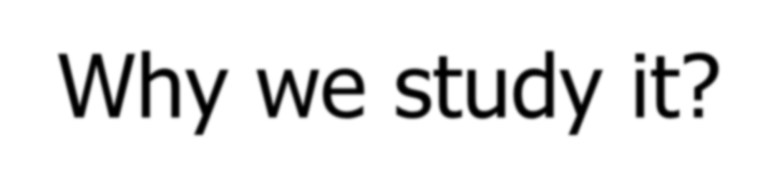
Allow us to think systematically about what machines do without going into hardware details.
Learning of language and computational techniques
Designing of theoretical model for machines
Theoretical model -> Abstract machine.

Slide 5
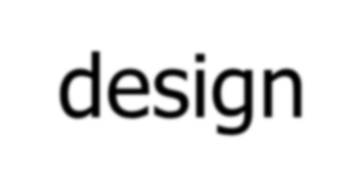
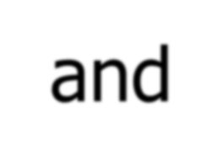
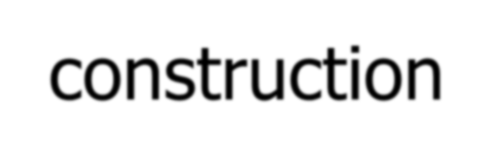
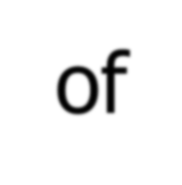
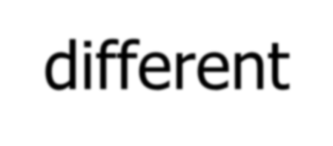
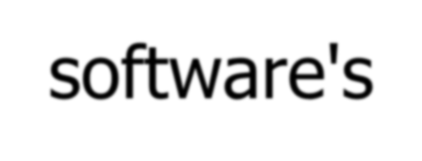
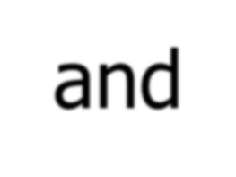
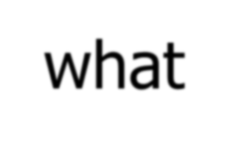

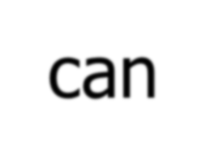

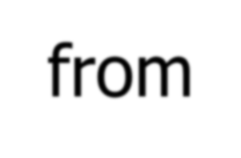

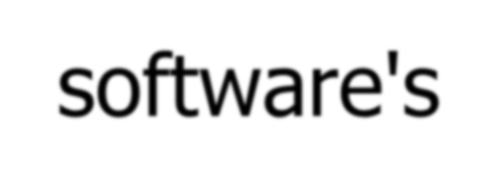
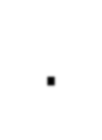
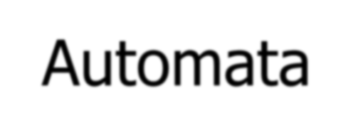
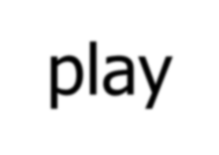
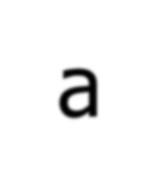

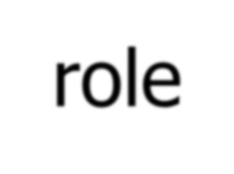
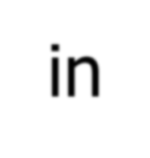
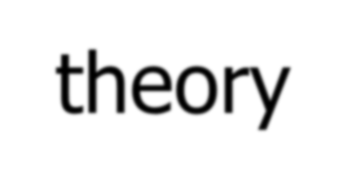

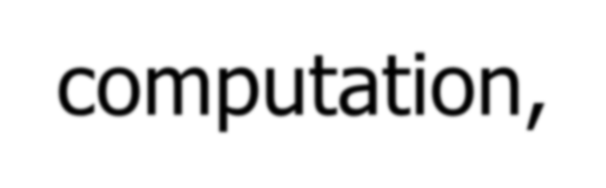
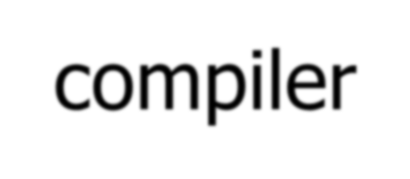
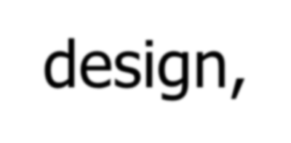
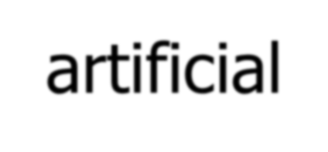

Helps in

Slide 6




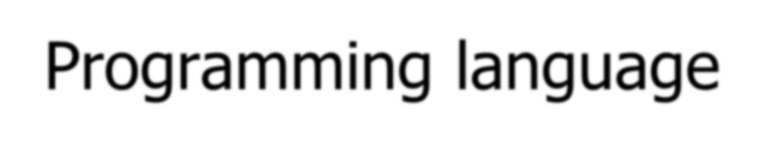
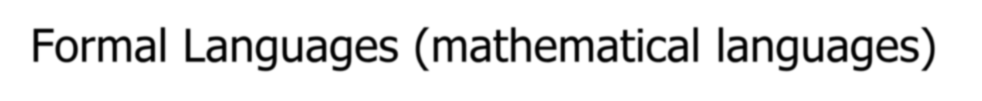

Slide 7

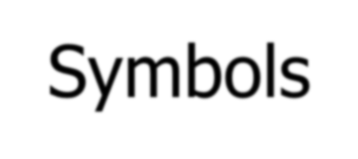

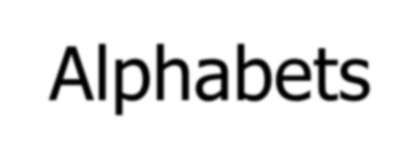
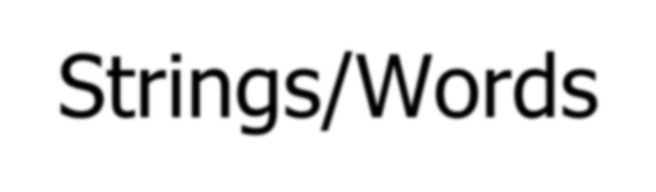

Slide 8
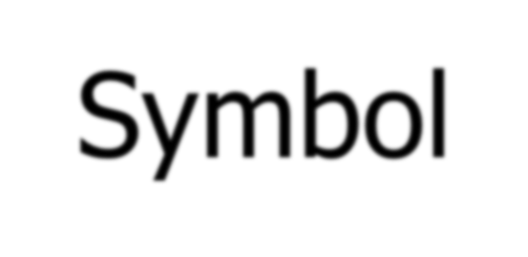
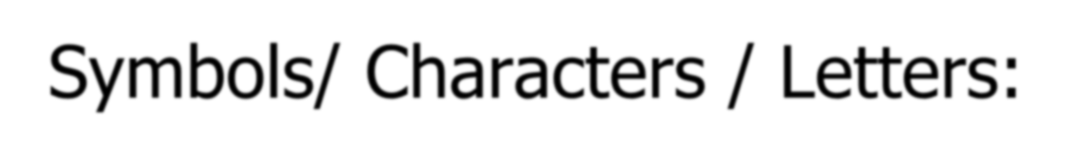
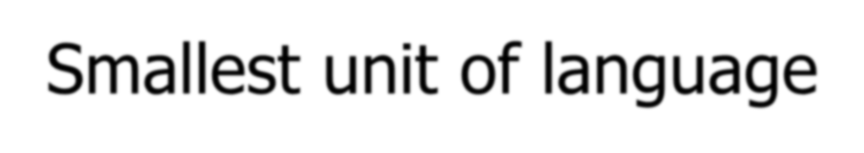
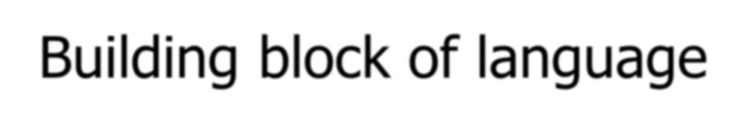
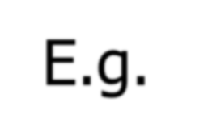
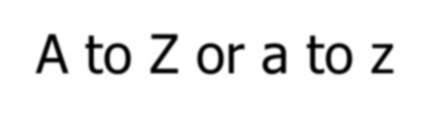

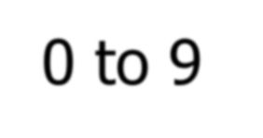
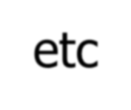

Slide 9

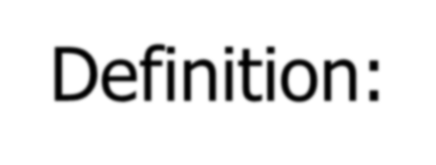
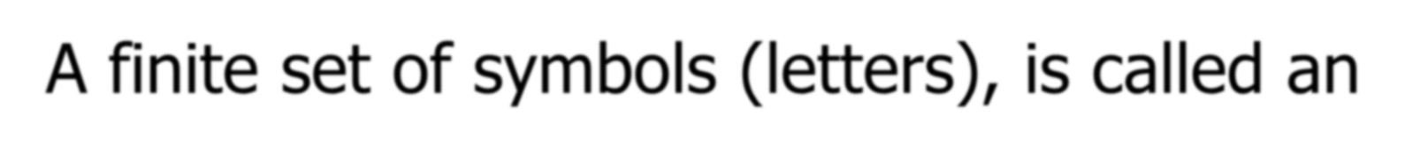
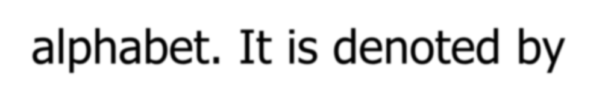
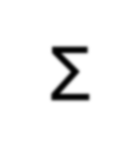
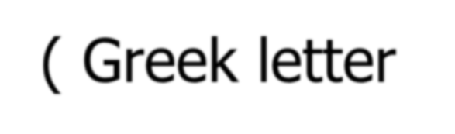
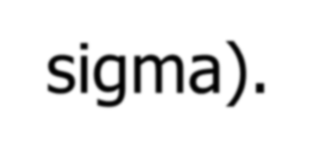
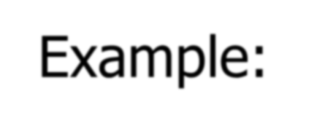
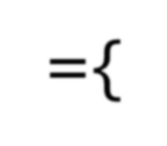
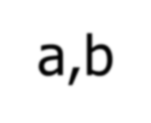
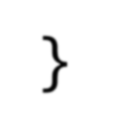
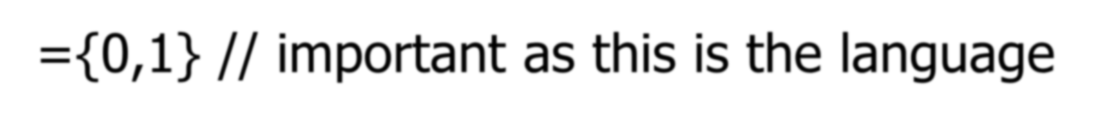
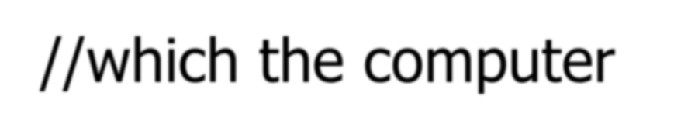
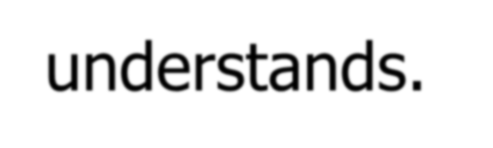
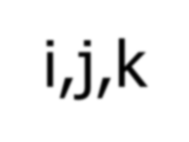


Slide 10






















Slide 11


















Slide 12
















Slide 13














Slide 14












Slide 15


















Slide 16

























Slide 17













Slide 18
Regular Expression:
Regular Expression is one of the language defining method
In this method, language is represented in terms of strings
It as an expression of strings and operators.
Operators:
  * → (kleene closure) → [a*]
• + → (kleene plus) → [a⁺]
. | → | (concatenation) → [ab]
• + | → | (union) → [a+b]

Slide 19
Kleene Closure/ Kleene star/ Kleene operator:
It is undetermined power, represent infinite number of terms can be made including empty string.
Denoted by * (star or asterisk)
* means (zero or more)
Example:
  ∑∗= {a}∗ = {^,a,aa,aaa,aaaa,aaaaa……}
  ∑∗= {a,b}∗ = {^,a,b,aa,ab,ba,bb,aaa,aab,aba,bbb,aabb,abab……}
  (ab*a) = {aa,aba,abba,abbba,abbbba,…….}
  (a*bba*) = {bb, abb, bba, abba, aabb, bbaa, aabba, abbaa, aabbaa,….. }

Slide 20
Kleene Plus/ Kleene Positive/ Positive closure:
It is also undetermined power, represent infinite number of terms can be made except empty string.
Denoted by + (plus/ positive)
• + means (one or more)
Examples:
  ∑⁺= {a}⁺ = {a,aa,aaa,aaaa,aaaaa……}
  ∑⁺= {a,b}⁺ = {a,b,aa,ab,ba,bb,aaa,aab,aba,bbb,aabb,abab……}
  (ab⁺a) = {aba,abba,abbba,abbbba,…….}
  (a⁺bba⁺= {abba, abbaa, aabba, aabbaa, aaabbaa….. }

Slide 21
Extended Regular Exp Notations
a? | → | (zero or one a’s)
[A-Z] | → | (Range from A to Z)
[x/y/z] | → | (either x or y or z)
xy | → | (concatenation)
R* | → | (zero or more)
R⁺ | → | (one or more)

Slide 22
Example
String contains any number of ‘a’ letters
L = { ^, a, aa, aaa, aaaa, …..}
R.E = ( a*)
String contains only ‘a’ letters
L = { a, aa, aaa, aaaa, …..}
R.E = (𝐚⁺)

Slide 23
Example
Every String starts with ‘a’ and contains any no of b’s. if ∑ = {a,b}
L = { a, ab, abb, abbb, abbbb, …..}
R.E = ( a . b*) → R.E = (ab*)

Slide 24
Example
Every String contains ‘a’ or ‘b’, if ∑ = {a,b}
L = { a, b}
R.E = ( a + b)
Every String contains any no of ‘a’ or any no of ‘b’, if ∑ = {a,b}
L = {^, a, b, aa, ab,ba, bb, aaa, aab, aba, baa, bbb,…..}
R.E = ( a + b)*

Slide 25
Example
Every string contains any number of “a’s” followed by bb, if ∑ = {a,b}
L = { bb, abb, aabb, aaabb, aaaabb, ….}
R.E = (a*bb)

Slide 26
Example
Every string contains any number of “ab”, if ∑ = {a,b}
L = { ^, ab, abab, ababab, abababab, ….}
R.E = (ab)*

Slide 27
Example
Every string contains any number of “a’s” followed by any no of “b’s”, if ∑ = {a,b}
L = { ^, a, b, ab, aab, abb, aaa, bbb, aaab, aabb, abbb, bbbb….}
R.E = (a* b*)

Slide 28
Example
Every string contains even number of a’s , if ∑ = {a}
L = { ^, aa, aaaa, aaaaaa, aaaaaaaa, ….}
R.E = (aa)*

Slide 29

Categories of Finite State Machines
FSM
FSM
With Output
With Output
Without Output
Without Output
Moore
Mealy
DFA
Moore
Mealy
DFA
NFA
NFA

Slide 30
Finite Automata (FSM without Output)
Finite Automata is an other method of defining languages
It’s a graphical method or pictorial representation of any machine.
Also known as Finite Automata Machine (FAM)
FA recognizes strings.
If the input ends and the FA is in an accept state then the string is “recognized”
A “language” can be described as a set of strings.
A language is called a regular language if some finite automata recognizes it.

Slide 31

FA consist of following parts: F.A= (Q, Σ, δ, q₀, F)
Q A finite set of states
Σ A finite input alphabet
q₀ The initial/starting state, q₀ is in Q F A set of final/accepting states,
δ A transition function

Slide 32
Types of states
Start / initial state → must contain 1 initial state
  Represented as
-x
-
Intermediate state → 0 or many
  Represented as
Final state/ Halting state/ Terminal state/ accepting state → 0 or many
  Represented as
+x
+

Slide 33
Example
L= {aa}
a
a
0
1
2
L={aba}
a
b
a
0
1
2
3

Slide 34

Types of Finite Automata
DFA:
  In the DFA, the machine goes to one state only for a particular input character.
  DFA does not accept the null move.
  Path should be defined for each non-accepting input at each state
  Halt state exist in DFA.
NFA:
  It is used to transmit any number of states for a particular input.
  It can accept the null move.
  No need to define path for non-accepting input at each state.
  Halt State does not exist in NFA.

Slide 35
DFA Example
DFA that accepts all strings including ^ string, if ∑= {a,b}
L={^, a, b, ab, ba, aa, bb, aba, bab….}
R.E= (a+b)*
+
a,b
-

Slide 36
Example
DF.A that does not accept any string, if ∑= {a,b}
L={^, a, b, ab, ba, aa, bb, aba, bab….}
a,b
-
a,b
R.E= (a+b)*
a,b
+
a,b
No final State
No starting state
Disconnected state
Or Unreachable state
a
-
a,b
a
b
+
b

Slide 37
Example
DFA that will accept the language starting with “a”, if ∑= {a,b}
L={a, ab, aa, abb, aba, abaa….}
R.E= a(a+b)*
-
a
+
a,b
b
a,b

Slide 38

Example
DFA that will accept the language having exactly three “a’s”, if ∑= {a,b}
L={aaa}
-
a
a
a
+
q1
q2
b
b
a,b
b
a,b

Slide 39
Non-Deterministic Finite Automata
NFA is actually DFA with different rules NFA consist of following parts:
NFA= (Q, Σ, δ, q₀, F)
Q A finite set of states
Σ A finite input alphabet
q₀ The initial/starting state, q₀ is in Q F A set of final/accepting states,
δ A transition function
NFA can move to more than one state, next state is not deterministic.
Dead state is not required in NFA
Can move to other state without any input (epsilon transactions)

Slide 40
Example
NFA that will accept the language ending with “a”, if ∑= {a,b}
L={a, aa, ba, aba, bba, abaa….}
R.E= (a+b)*a
DFA
b
NFA
a
a,b
-
a
+
-
a
+
b

Slide 41
Example
NFA that will accept single “a”, if ∑= {a,b}
R.E = a
DFA
NFA
-
a
+
-
a
+
b
a,b
a,b

Slide 42

Example
NFA that will accept the language having exactly three “a’s”, if ∑= {a,b}
L={aaa}
a
q 1
a
q 2
a
NFA
-
+
b
-
a
q 1
a
q 2
a
+
b
a,b
DFA
b
a,b

Slide 43


Example with epsilon move
R.E= a*b*c*

Slide 44

Categories of Finite State Machines
FSM
With Output
Without Output
Moore
Mealy
DFA
NFA

Slide 45
Moore Machine
Moore machine is a finite state machine that generates output
Moore machine is FA whose outputs depend on only the present state.
A Moore machine can be described by a 6 tuple (Q, ∑, ∆, δ, 𝜆 , q₀) where
−
Q is a finite set of states.
∑ is a finite set of symbols called the input alphabet.
∆ is a finite set of symbols called the output alphabet.
δ is the input transition function where δ: Q × ∑ → Q
𝜆 is the output transition function where 𝜆 : Q → ∆
q₀ is the initial state from where any input is processed (q₀ ∈ Q).

Slide 46
Important points
We refer to the input symbol as input letter and output symbol as characters
Moore machine always starts working by printing a character by the mandatory start state.
If the input letters (run on machine) are ‘n’ then output letters must be “n+1”
Moore machine will not define any language or not work to accept any string, so the process will be terminated when the last input letter from input string is read and last output character is printed
There will be always 2 symbols in each state separated by “/” sign. On the left, will be the state name and on the right, output printed by that state.

Slide 47


Slide 48


Slide 49


Slide 50

Example
Construct Moore machine which prints 1 for every substring “ab”, if
∑={a,b} and ∆ = {0,1}

Slide 51


Slide 52

Example
Construct Moore machine which prints 1 for every substring “baa”, if
∑={a,b} and ∆ = {0,1}

Slide 53


Slide 54
Categories of Finite State Machines
FSM
With Output
Without Output
Moore
Mealy
DFA
NFA

Slide 55
Mealy Machine
Mealy machine is a finite state machine that generates output
A Mealy machine is a machine in which output symbol depends upon the present input symbol.
In the Mealy machine, the output is represented with each input symbol for each state separated by /.
A Mealy machine can be described by a 6 tuple (Q, ∑, ∆, δ, 𝜆 , q₀) where −
Q is a finite set of states.
∑ is a finite set of symbols called the input alphabet.
∆ is a finite set of symbols called the output alphabet.
δ is the input transition function where δ: Q × ∑ → Q
𝜆 is the output transition function where 𝜆 : Q × ∑ → ∆
q₀ is the initial state from where any input is processed (q₀ ∈ Q).

Slide 56
Important points
Printing will be done while traveling along the edges or paths instead of states
Output depends upon the input
Same number of characters as letters.
If the input letters (run on machine) are ‘n’ then output letters must be “n”
No final state exist.
Each edge is labeled by a compound symbol “(Input/Output)”.

Slide 57


Slide 58


Slide 59


Slide 60

Mealy machine Example
0

Slide 61

Example
Construct Mealy machine for binary number as input and produce 1’s compliment of that number.
∑={0,1} and ∆ = {0,1}

